Slide 1



Slide 2



01CE0503 - Design and Analysis of Algorithm
Unit - 8
String Matching
Prof. Jaydeep K. Ratanpara
Computer Engineering Department

Slide 3



OUTLINE
The Rabin-Karp algorithm
The naive string matching algorithm
String Matching with finite automata
The Knuth-Morris-Pratt algorithm.

Slide 4
The Rabin-Karp algorithm
Comparing numbers is easier and cheaper than comparing strings. Rabin Karp algorithm represents strings in numbers.
Suppose p represents values corresponding to pattern P[1…m] of length m. And ts represents values of m-length substrings T[(s + 1) … (s + m)] for s = 0, 1, 2, …, n – m.
Rabin Karp algorithm is based on hashing technique. It first computes the hash value of p and ts.

Slide 5
The Rabin-Karp algorithm
If hash values are same, i.e. if hash(p) = hash(ts), we check the equality of inverse hash similar to a naïve method. If hash values are not same, no need to compare actual string.
On the hash match, actual characters of both strings are compared using brute force approach. If the pattern is found, then it is called hit. Otherwise, it is called a spurious hit.
However, the same hash value does not ensure the string match. Two different strings can have same hash values. That is why we need to compare them character by character on hash hit.

Slide 6
The Rabin-Karp algorithm
Example: Explain spurious hits in Rabin-Karp string matching algorithm with an example. Working modulo q = 13, how many spurious hits does the Rabin-Karp matcher encounter in the text T = 2359023141526739921 when looking for the pattern P = 31415 ?
Solution:
Given pattern P = 31415, and prime number q = 13
P mod q = 31415 mod 13 = 7
Let us find hash value for given text :
T[1…5] = 23590 mod 13 = 8
T[2…6] = 35902 mod 13 = 9
:
T[(m – 4) … m] = 39921 mod 13 = 11

Slide 7
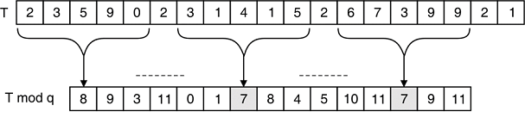
The Rabin-Karp algorithm

Slide 8
The Rabin-Karp algorithm
The hash value of pattern P is 7. We have two such values in a hash(T).
So there may be a spurious hit or actual string.
In given text T, one hit is an actual match and one is spurious hit.
If the hash of pattern and any substring in the text is same, we have two possibilities :
(i) Hit : Pattern and text are same
(ii) Spurious hit : Hash value is same but pattern and corresponding text is not same

Slide 9
The Rabin-Karp algorithm
Here, m = length of pattern = 5.
Consider ts = 23590.
Next value ts+1 is derived as,
ts+1 = 10(ts) – 10m* T[s+1] + T[s + m + 1] )
= (10*23590) – 105 * 2 + 2
= 235900 – 200000 + 2 = 35902
ts+2 = 10(ts+1) – 10m* T[s+2] + T[s + m + 2] )
= (10*35902) – 105 * 3 + 3
= 359020 – 300000 + 3 = 59023
In same way, we can compute the next ts+i using incremental approach.

Slide 10
The Rabin-Karp algorithm
Rabin Karp algorithm matches hash value, rather than directly comparing actual string value. If hash value of pattern P and the hash value of subsequence in string T are same, the actual value of strings is compared using brute force approach. Like ts+1, we can also derive hash value incrementally as shown below.
Calculation for hash of 14152
If ts is known, the hash value can directly be derived for ts+1 as follow.
Hash for ts+1 = (d*(ts – T[s+1]h) + T[s + m + 1]) mod q
= 10*(31415 – (3*104 mod 13)) + 2 mod 13
= 10(31415 – 9) + 2 mod 13
= 314062 mod 13
= 8

Slide 11
String Matching with Finite Automata
Idea of this approach is to build finite automata to scan text T for finding all occurrences of pattern P. This approach examines each character of text exactly once to find the pattern. Thus it takes linear time for matching but pre-processing time may be large.
Finite automata is defined by tuple M = {Q, S, q0, F, d}, where
Q = Set of states in finite automata
S = Set of input symbols
q0 = Initial state
F = Set of final states
d = Transition function defined as d : Q x S → Q

Slide 12
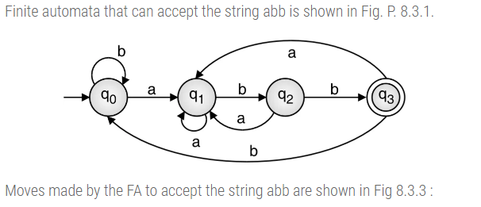
String Matching with Finite Automata
Example : Construct and show simulation of finite automata for matching the pattern P = abb for text T = ababbaababba

Slide 13
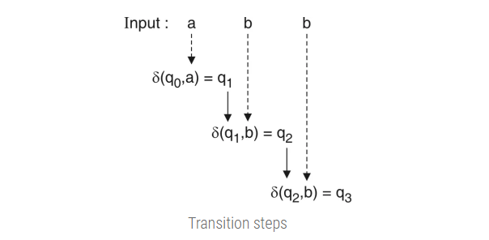
String Matching with Finite Automata

Slide 14
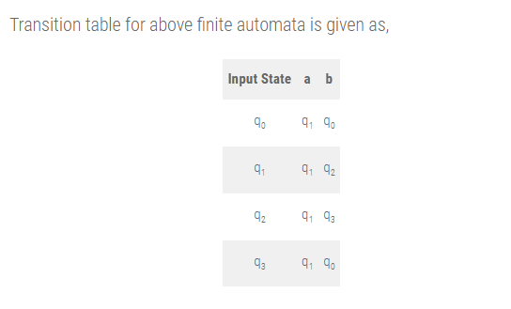
String Matching with Finite Automata

Slide 15
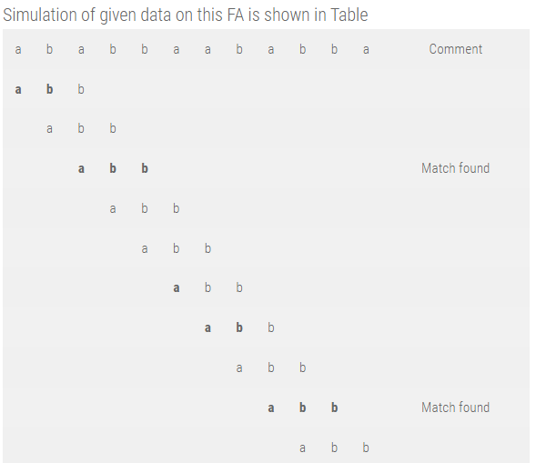
String Matching with Finite Automata

